Slide 1
ForeUp
Login Information

Slide 2
Reset Password
From your original email time stamped Fri 1:20, Click on: To reset your account password click here

Slide 3
Reset Password continued…
Type in your new Password
Confirm your new Password
And click on reset

Slide 4
Updated Account Information
Once you’ve reset your password, go back to your original email time stamped 1:20
and click on the link:
Nabnasset Lake Country Club Online
Booking

Slide 5
NLCC Booking Engine
Once you click on the link, this screen will come up. You only have access to your membership status.
For this example, I used unrestricted

Slide 6
NLCC Tee Sheet
Select the day
How many players
Time of day
9 or 18 holes (NEVER SELECT BOTH)

Slide 7
Tee Sheet continued….
In this example, we chose March 16th as the date.
Players 2
Time of Day all
Holes 18
Next step is to pick a t-time and click on Reserve
I chose 8:00 AM
Note: To assure your looking at the
most recent t-sheet, don’t forget
to refresh the page

Slide 8
Tee Sheet continued….
Once you click on reserve, this screen comes up.
You have 5 minutes to book your
t -time.
Click on Book Time

Slide 9
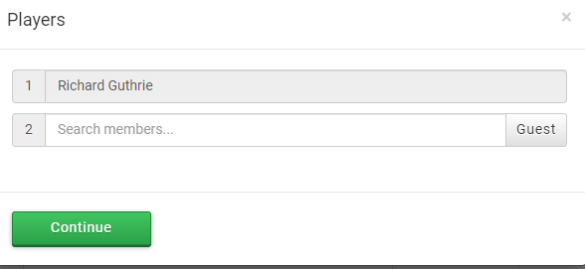
Tee Sheet continued….
When you click on book time, this screen comes up. Start typing a name, and a pop-up will appear. You have to type in at least 3 characters for the list of people. You can use the first or last name.
If you’re making a t-time for a non-member, click on guest. DO NOT TYPE
IN AN ANONYMOUS NAME.
Click on a player and then click on continue

Slide 10
T Sheet continued….
Reservation has been booked. A confirmation email will be sent to you.
Notice, you can reserve an additional t-time.
If you click on reserve an additional t-time, the t sheet screen will automatically pop back up
If you selected 18 holes, the system will automatically book the turn for 2hrs, 10 minutes out

Slide 11
T Sheet continued….
DO NOT USE THE CHANGE BUTTON
The change button is to change your member status (ex. Unrestricted to restricted)
To make any changes to your t-time, you have to go to the update /cancel screen

Slide 12
Update Reservation
To update or cancel a reservation, go to my account, my reservations.
This screen will appear

Slide 13
Update Reservation continued….
On the update screen you can add players.
Click on update
The Update Reservation screen
appears. Click on New Player Count.
Then click on Update Reservation

Slide 14
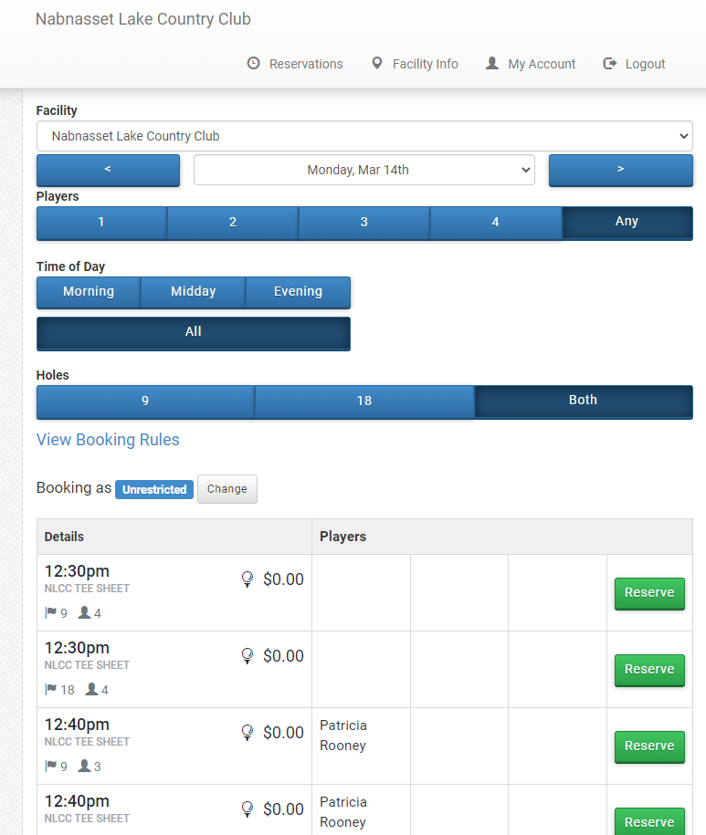
Update Reservation continued…
To get back to the t-sheet screen, click on Reservations at the top of the screen

Slide 15
Update Reservation continued….
When adding players to a reservation with only 1 name, it appears as Guest on the t-sheet. At this time, names cannot be added in.
When players are updated (ex. From 4 to 2) their names still appear on the t-sheet. The reserve button will be highlighted again, allowing additional players to sign up.

Slide 16
Cancel Your Reservation
You can also cancel the reservation by clicking on cancel.
A pop up will appear, click on OK and the T-time is successfully cancelled

Slide 17
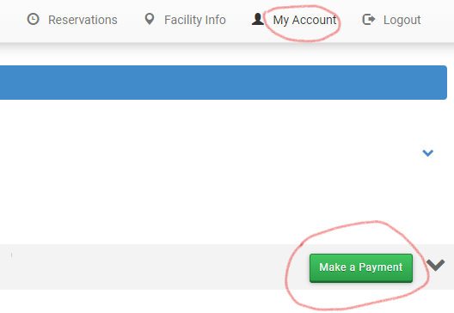
Make A Payment
Under your account, you can also make a payment. Click on My Account, make a payment.
A pop-up screen will appear to add your payment information

